Slide 1

Del17p Data Set
Samples | Source | # of cases | Analysis | Clinical outcome | Objective
Del17p CLL (Mix of W&W, 1L and R/R) | Mayo Clinic | Peripheral blood, n=58 | RNAseq 60XWGS ATACseq Immunophenotyping Complex Karyotyping | Yes | Define the underlying biology of high risk del17p patients using integrated analysis of genetic, epigenetic, transcriptomic and immune profiling

Slide 2
Current Sample status
Batch | Samples received (PBMCs) | 60X/30X WGS | RNAseq | Data processing
Pilot Study | 12 CD19+ DNA/RNA 12 CD19- DNA | 12T/10GL | 10 | Initial processing through pipeline
Batch 1/ March 30th | 25 CD19+ DNA/RNA 25 CD19- DNA | 23T/23GL | Data received from EA | Initiated for WGS
Batch 2/ Jun 16th | 21 CD19+ DNA/RNA 21 CD19- DNA | 21T/21GL | Data received from EA | Initiated for WGS
Total | 58 | 56
WGS data processing is initiated and expected to take 3-4 weeks

Slide 3
del17P Pilot Study* (n=12)
Objective (for NGS)
Determine tumor and germline purity achieved by using cell fractionation
Define the effect of high tumor in normal contamination on variant calling Do we need to define a threshold for contamination?
Plan
N=12 PBMC samples from patients with del17p (± complex karyotype) selected for NGS, immunophenotypying, CK and bulk ATACseq
For NGS, Mayo optimized fractionation; contamination below<10%
Results
Very low RNA yield using EA protocol.; Mayo to extract DNA/RNA
Variant calls by Mutect on standard pipeline; no association of variant calls to contamination
Samples to be run on alternative tumor and control pipeline; check against hotspot mutations in CLL for further confidence in data
CNV calling by Battenberg ongoing
Sample | Total (ug) | % TIN | % live cells | Somatic Mutation calls
2327 | 2.798 | 17 | 59.1 | 21
3146 | 2.2 | 15.2 | 28.7 | 13
1292 | 2.842 | 11 | 90.1 | 18
2297 | 0.402 | 7.6 | 35.4 | 9
3520 | 1.021 | 6.5 | 72.5 | 6
2946 | 1.778 | 4.4 | 66 | 9
3034 | 1.954 | 3.3 | 68.3 | 23
4000 | 2.094 | 3 | 61.2 | 23
2596 | 2.182 | 2.9 | 53.8 | 14
4090 | 2.332 | 2.17 | 75.7 | 30
* See slide deck for details

Slide 4
Analysis Plan for WGS data
Assess data quality of WGS
Tumor in normal contamination? (checking data with Mayo)
Patient demographic and clinical characteristics of the final cohort ( after data QC)
Genomic landscape of the Del17p cohort
Identify driver genes associated with Del17p patient profile
P53 status to identify bi-allelic group
CNVs associated with Del17p

Slide 5
Del17p cohort (Project 2)
Baseline characteristics
Overall survival

Slide 6
Baseline characteristics (n=58)
Characteristic |  | N (%) or [range]
Number of patients |  | 58
Del17p by FISH |  | 100
Median age, years |  | 69 [44-86]
Males |  | 34 (59)
Median time from CLL diagnosis to sample analysis, years |  | 0.1 [0.1 – 26.1]
Years from diagnosis to treatment, years |  | 0.8 [0.8 – 27.4]
Charlson co-morbidity index | Low (0-3) | 38 (66)
 | Intermediate (4-5) | 12 (21)
 | High (6-7) | 6 (10)
 | Very high (≥8) | 2 (3)

Slide 7
Baseline characteristics (n=58)
Characteristic |  |  | N (%) or [range]
Rai Stage | 0 | 0 | 17 (31)
 | 1 | 1 | 15 (28)
 | 2 | 2 | 7 (13)
 | 3 | 3 | 4 (7)
 | 4 | 4 | 11 (20)
Mutated TP53 (n=24) |  |  | 18 (75)
Unmutated IGHV (n=53) |  |  | 34 (64)
CD38 ≥ 30% (n=56) |  |  | 27 (48)
ZAP-70 ≥ 20% (n=51) |  |  | 26 (51)
CD49d ≥ 30% (n=51) |  |  | 22 (43)
CLL FISH abnormalities other than del17p* |  | Del13q | 34
 |  | Del11q | 9
 |  | Trisomy12 | 9
 |  | Other | 6
 |  | Sole del17p | 12
*total exceeds 58 since some patients may have multiple FISH abnormalities

Slide 8
Baseline characteristics (n=58)
Type of treatment |  | N (%)
Untreated |  | 16 (27%; median follow-up 7.9 months [0 – 139])
CIT | Pentostatin-based treatment | 6
 | CFAR | 2
BTKi-based therapy | Ibrutinib-based treatment | 13
 | Acalabrutinib-based treatment | 3
Monoclonal antibody-based treatment | Alemtuzumab + rituximab* | 9
 | Rituximab +/- methylprednisolone | 6
Other** |  | 3
*Given as part of an early intervention protocol
**including chlorambucil (n=1) and R-CHOP (n=2)

Slide 9
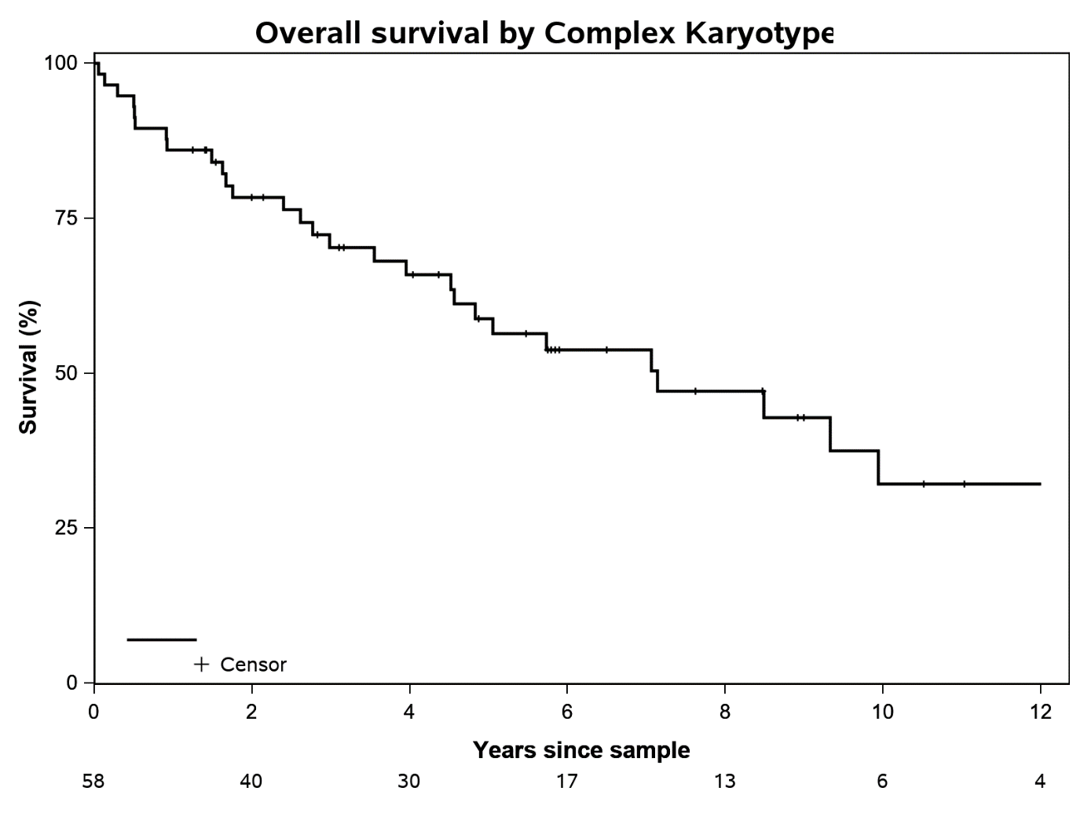
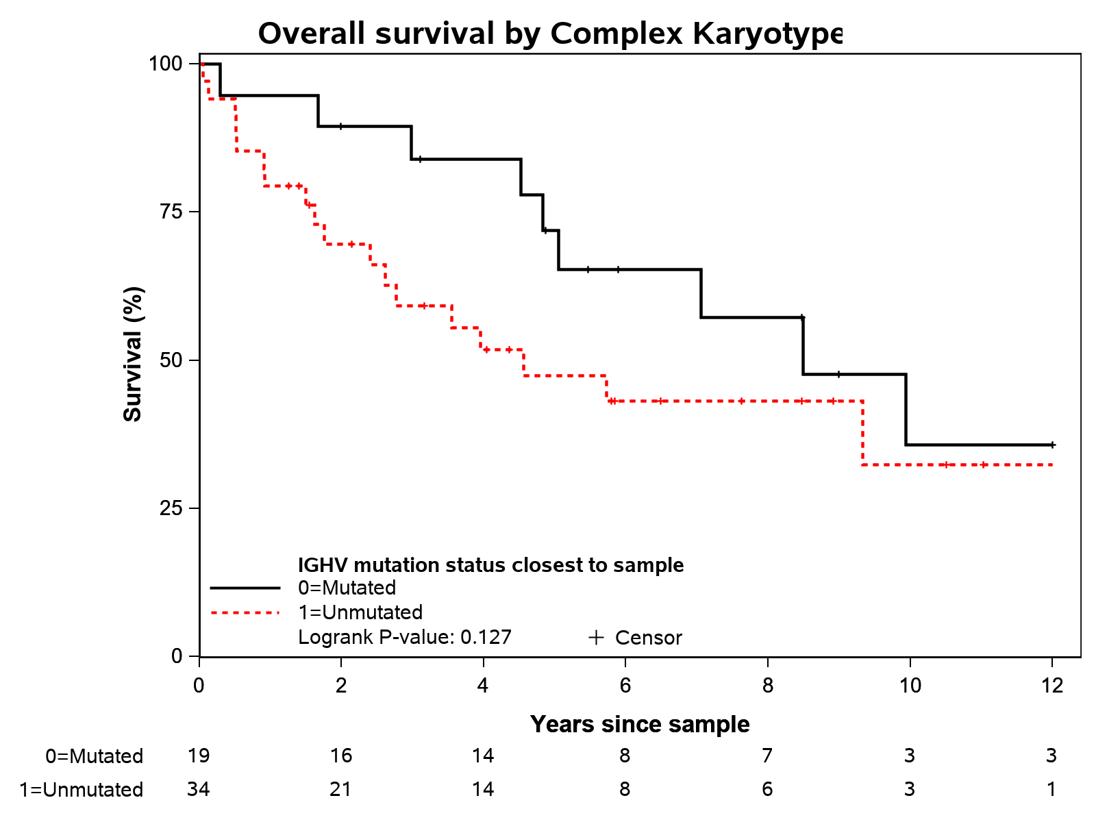
OS for the entire cohort
Median OS = 7.1 years
No difference in OS according to IGHV mutation status

Slide 10
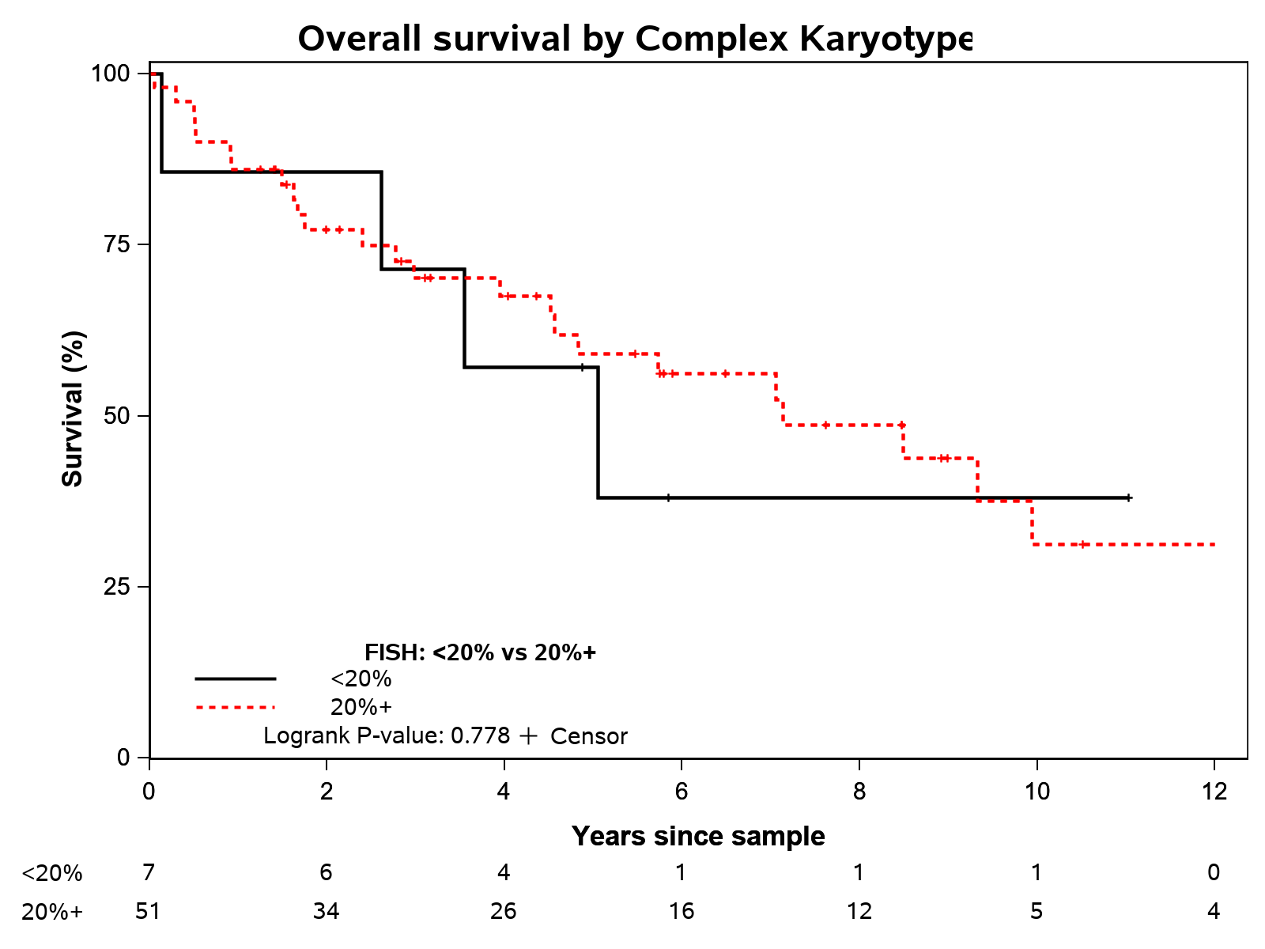
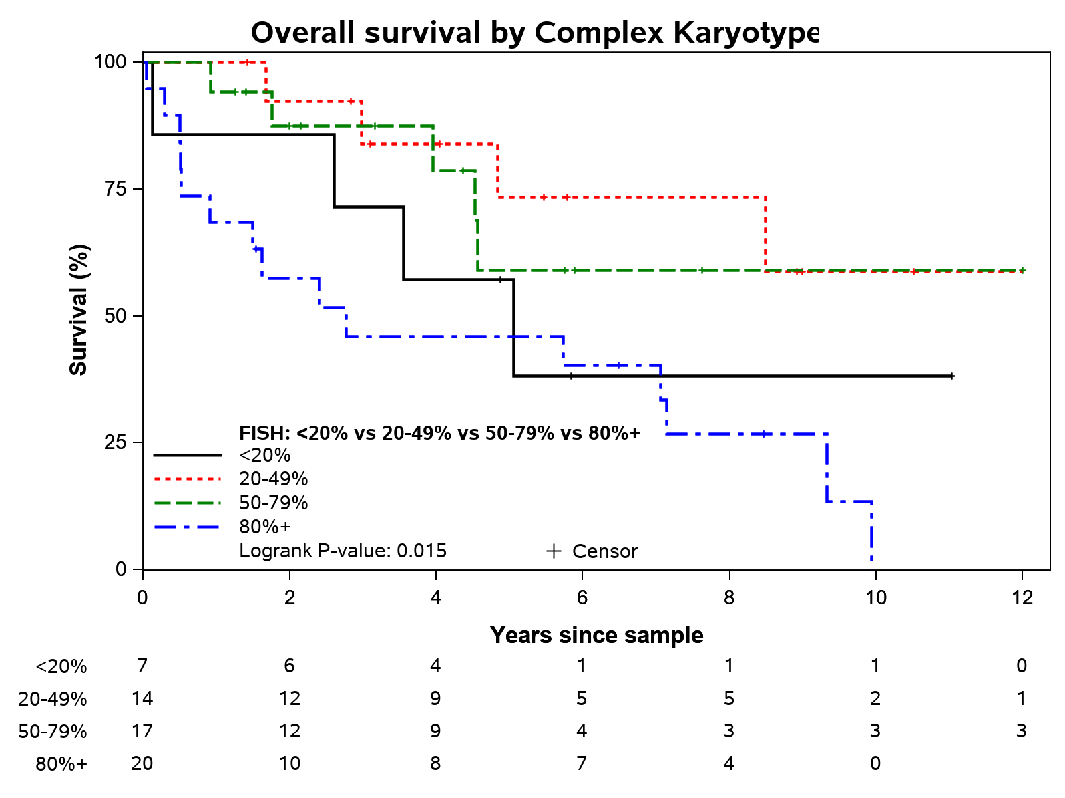
OS according to %abnormal nuclei in del17p

Slide 11
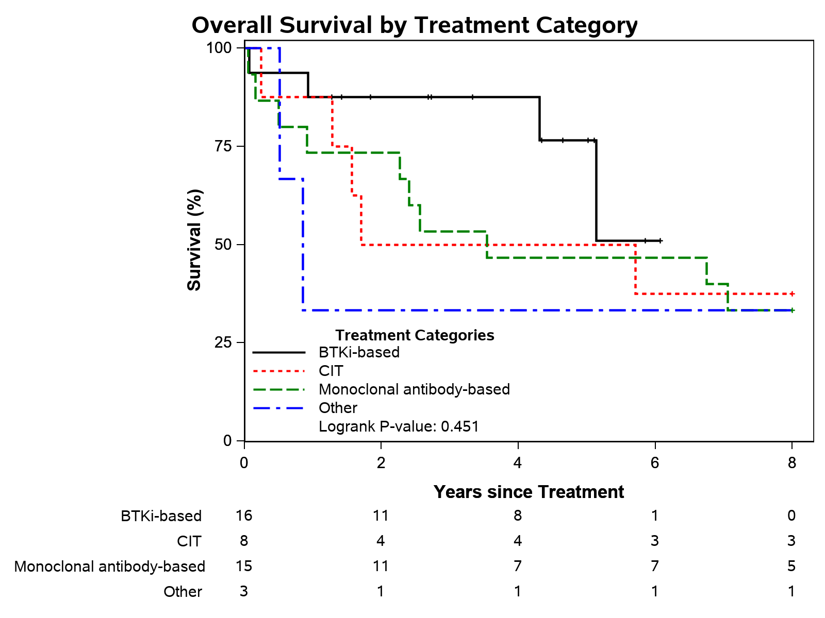
OS according to treatment type

Slide 12
Background

Slide 13

CLL Journey and Clinical High-Risk segments
Induction | 1st Relapse | 2nd Relapse
FCR BR Ibrutinib Venetoclax + G | Ibrutinib BR Venetoclax ± R Acalabrutinib | Venetoclax ± R Idelalisib + R
Obin. + CL Ibrutinib Venetoclax + G | Ibrutinib Venetoclax ± R Idelalisib + R | CD20 mono
Ibrutinib Venetoclax ± G | Venetoclax ± R Ibrutinib Idelalisib + R | Venetoclax ± R Idelalisib
STANDARD RISK
Younger than 80
Few comorbidities
Absence of del17p
ASYMPTOMATIC
WATCH & WAIT
(~40%)
FRAIL
Older than 80
Poor ECOG status (>1)
Moderate to severe comorbidities- (CIRS>6 and/or renal dysfunction)
CLL Diagnosis
& Risk
Stratification
SYMPTOMATIC
HIGH RISK
High risk defined by presence of del17p or TP53 mutation
SYMPTOMATIC
RICHTER’s TRANSFORMATION
R-CHOP, R-EPOCH
Novel agents are now foundational therapy in CLL but are not curative
Hallek, AJH, 2019
Notes:
least 1 of the following criteria should be met. 1. Evidence of progressive marrow failure as manifested by the development of, or worsening of, anemia and/or thrombocytopenia. Cutoff levels of Hb ,10 g/dL or platelet counts ,100 3 109/L are generally regarded as indication for treatment. However, in some patients, platelet counts ,100 3 109 /L may remain stable over a long period; this situation does not automatically require therapeutic intervention.
2. Massive (ie, $6 cm below the left costal margin) or progressive or symptomatic splenomegaly.
3. Massive nodes (ie, $10 cm in longest diameter) or progressive or symptomatic lymphadenopathy.
4. Progressive lymphocytosis with an increase of $50% over a 2-month period, or lymphocyte doubling time (LDT) ,6 months. LDT can be obtained by linear regression extrapolation of absolute lymphocyte counts obtained at intervals of 2 weeks over an observation period of 2 to 3 months; patients with initial blood lymphocyte counts ,30 3 109 /L may require a longer observation period to determine the LDT. Factors contributing to lymphocytosis other than CLL (eg, infections, steroid administration) should be excluded.
5. Autoimmune complications including anemia or thrombocytopenia poorly responsive to corticosteroids.
6. Symptomatic or functional extranodal involvement (eg, skin, kidney, lung, spine).
7. Disease-related symptoms as defined by any of the following:
a. Unintentional weight loss $10% within the previous 6 months.
b. Significant fatigue (ie, ECOG performance scale 2 or worse; cannot work or unable to perform usual activities).
c. Fevers $100.5°F or 38.0°C for 2 or more weeks without evidence of infection.
d. Night sweats for $1 month without evidence of infection

Slide 14
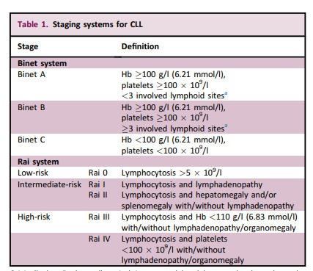
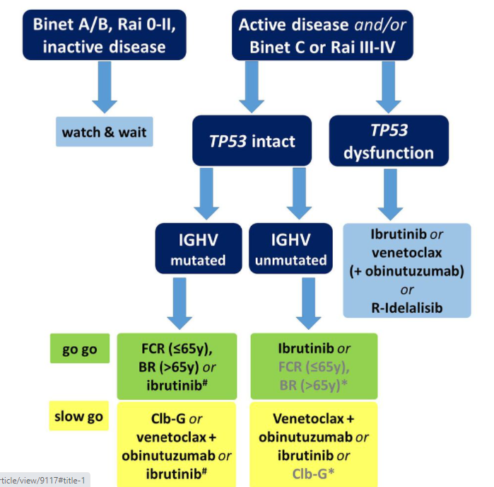
Treatment algorithm

Slide 15
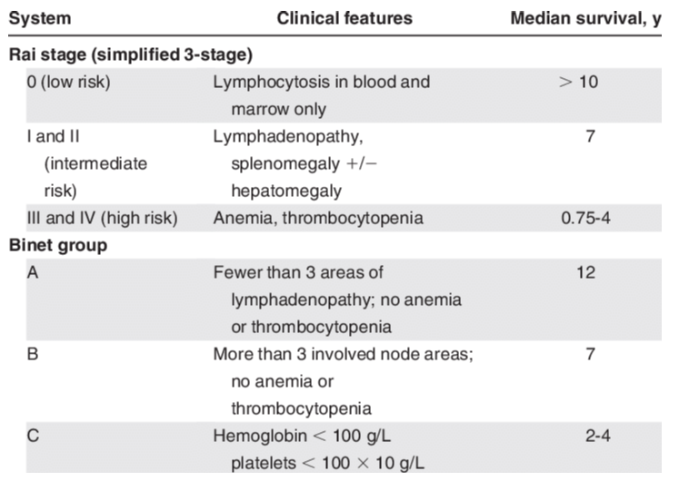
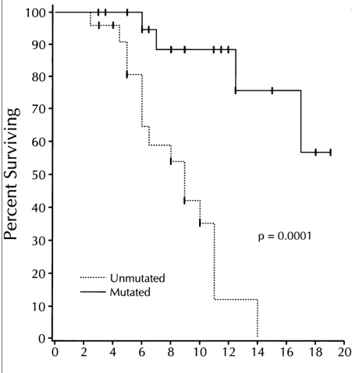
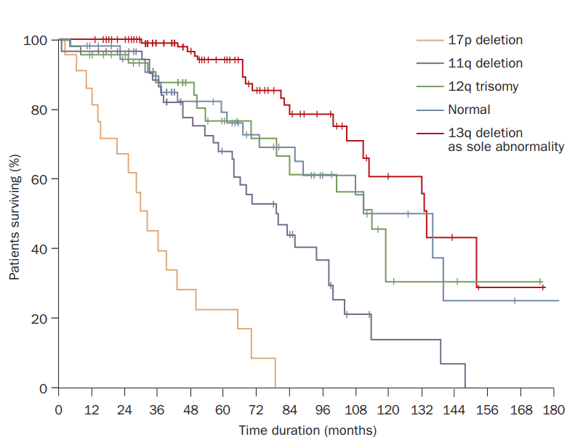
CLL staging and prognostic factors
1975
1981
Years from diagnosis
Staging
IGHV status
Cytogenetics
Genomic aberrations are independent predictors of disease progression and survival
Damle et.al., Blood 1999
Döhner H et al. N Engl J Med 2000
Notes:
23,56,47,57,117

Slide 16
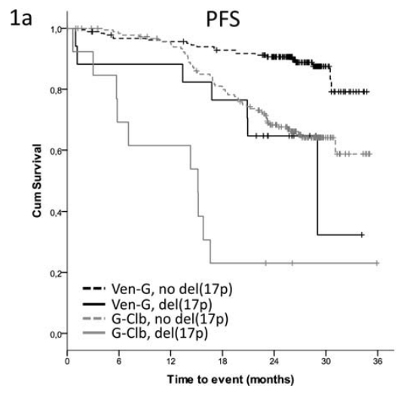
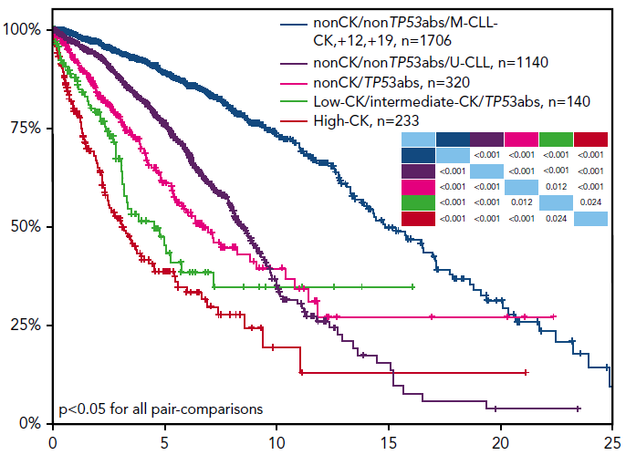
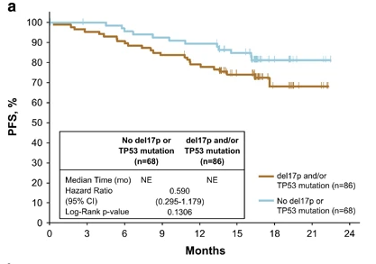
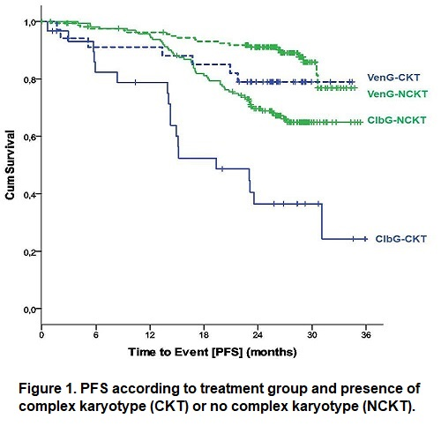
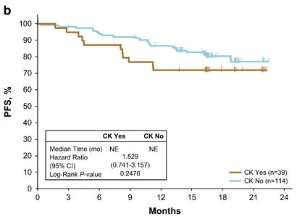
1. Del17p/TP53 mutated population
Del17p
5-10% in 1L CLL ; 40% in r/r CLL
Del17p and/or p53 mutation status alone is currently defined as high risk in CLL, however is associated with heterogeneity in outcomes
Highly associated with Complex Karyoytpe
Numerical and structural cytogenetic abnormalities as tested by chromosome banding analysis
Present in 10-30% CLL population
Conventionally defined as ≥ 3 abnormalities in at least 10 metaphases. Recently ≥ 5 abnormalities defined as high risk CK independent of clinical or other genetic factors
1L CLL with Ven-Obino
and chemo (CLL14)
R/R CLL with Ibrutnib (RESONATE)
% Alive

Slide 17
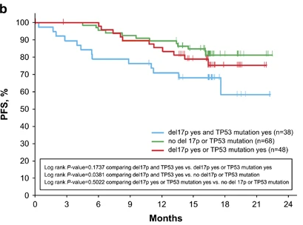
1. del17p Population –Unmet need with novel agents
CLL 14 Trial in 1L CLL
(Venetoclax-G vs Clb-G)
PFS by del17p and TP53 subgroup
RESONATE Trial in rrCLL(Ibrutinib vs Ofatumumab)
Novel targeted therapies minimize prognostic impact of TP53 alterations but presence of del(17p) and/or TP53 mutation is the only factor associated with increased probability of MRD⁺ at EOI and progressive disease
Al-Sawaf, EHA 2019;
Brown, Leukemia, 2017;

Slide 18
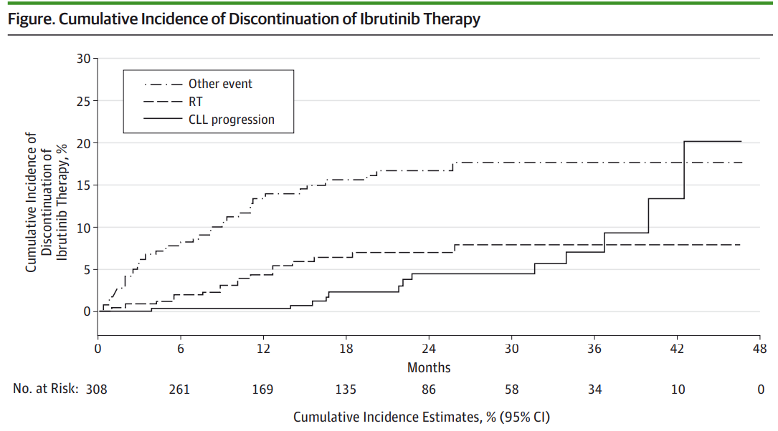
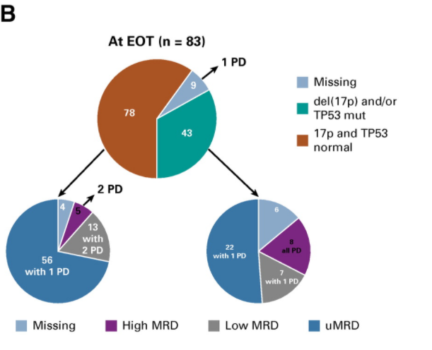
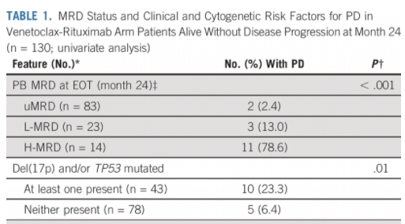
2.Post novel agent relapsed population
Disease progression on Ibrutinib/Venetoclax remains challenging to treat
Improved PFS with novel agents but remain high risk for progression
Two major types of disease progression:
CLL progression
Progression to large cell lymphoma (DLBCL)
Presence of del(17p) and/or TP53 mutation associated with increased probability of MRD⁺ and PD after EOT. (R/R CLL, MURANO Trial,/ Ven-Ritx)
Maddocks, JAMA Oncology, 2015;1(1):80

Slide 19
What’s published in del17p CLL?
Study | n | Treatment | mP53/del17p | Assay | Findings
Rossi et.al., 2014 | 309+ 13 | nd 36% got FCR 13 samples at relapse | 46 (25 are del17p) | TP53 NGS (2500x) Cytogenetics available BIRC3, MYD88, SF3B1 and NOTCH1 mutations | Small TP53 mutated subclones occur in a significant fraction of newly diagnosed CLL (15% NGS vs 9% Sanger) Small TP53 mutated subclones have the same unfavorable prognostic impact as clonal defects (5-year OS: 46.3% vs 36%) Small TP53 mutated subclones detected at diagnosis expanded under the selective pressure of treatment
Delgado et.al., 2014 | - | nd and treated | 55 (40 are del17p) | CBA SNP Array | genomic complexity and IGHV mutational status are the main predictors of OS in CLL patients with TP53 disruption
Yu et.al., 2017 | 277 | nd 51% del17/19% WT were treated (F/B/R) | 69 del17p (mix of watch and wait and treated) | SNP Array WES 80X Sanger Sequencing TP53 FISH | More CNAs were seen in del(17p) than WT del(17p) CLL has a longer total length of deleted (97Mb vs 1.2Mb); del(17p) CLL cases have recurrent deletions at 3p, 4p, or 9p and has a unique driver mutation profile (NOTCH1, RPS15, DDX3X, and GPS2) 81% of del17p have TP53 mutations, clonal mutations are prognostic Complex karyotyping and CNAs predict need for treatment
Yuan et al., 2018 | 305 | Watch and wait | 41 (30 are del17p) | Cytogenetics Sanger sequencing | Lower percentage of cells with del(17p) predicted better survival
Brieghel et al., 2021 | 51 | nd + RR Ibrutinib | 47 are del17p | FISH P53 by NGS | Patients with multi-hit P53 (vs single hit) have a significantly shorter overall survival, PFS and time-to-progression (TTP)

